Slide 1


RetINaBox
Lesson Plans

Slide 2
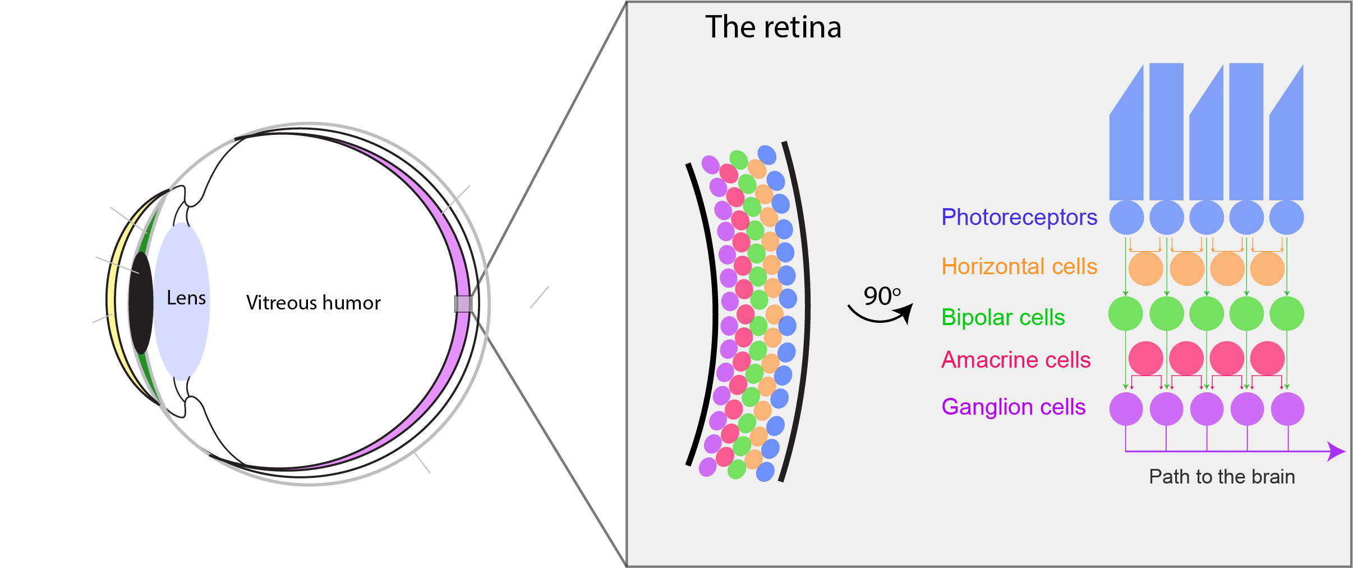
How do we see?
The retina

Slide 3
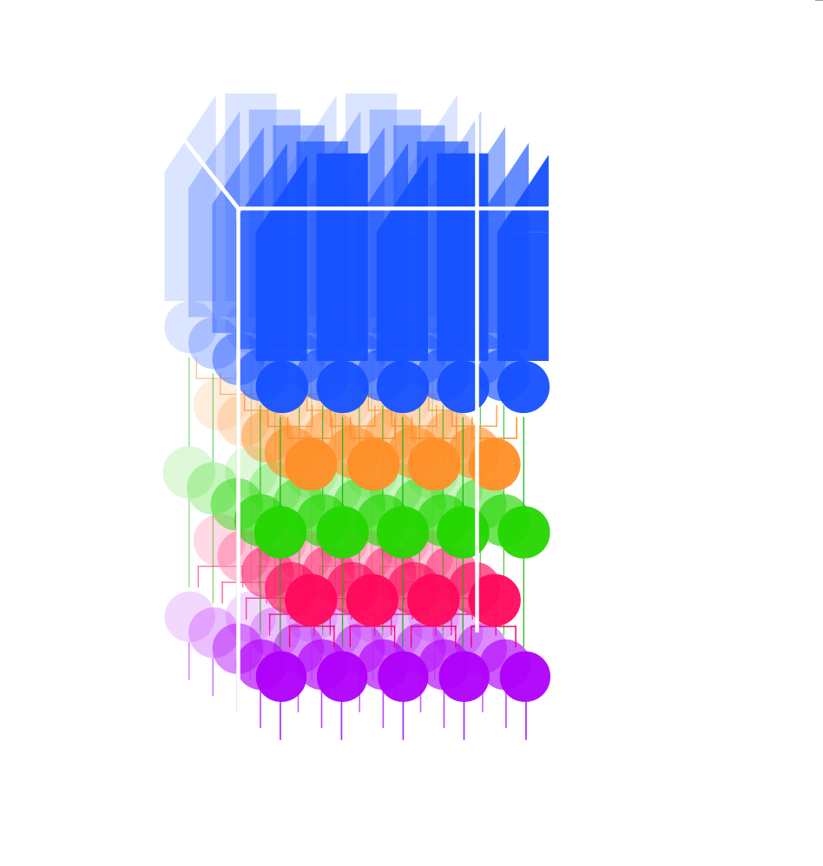
How do we see?
The retina
Photoreceptors are arranged in a dense 3D arrangement.
Within a given retinal layer, cells form a 2D mosaic.

Slide 4
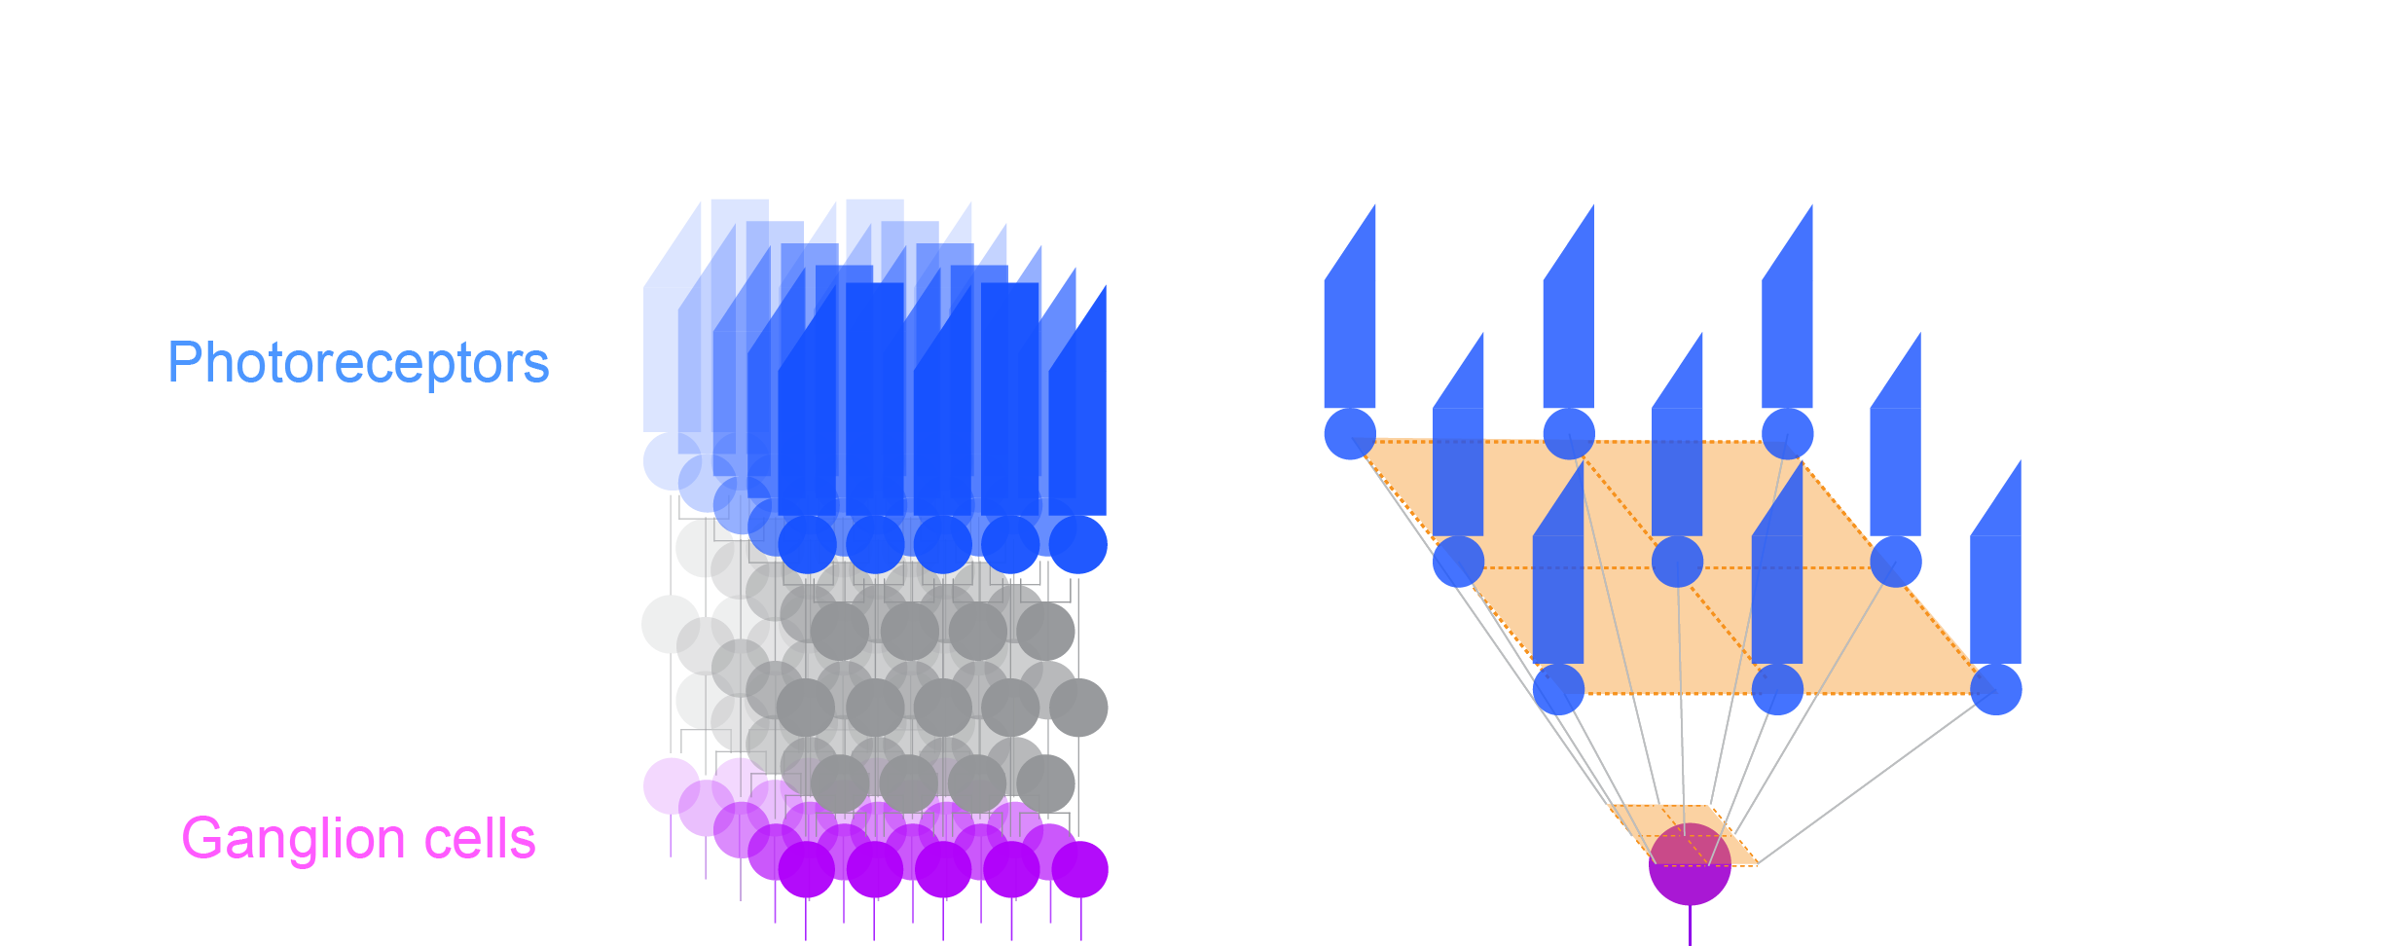
How do we see?
The retina

Slide 5
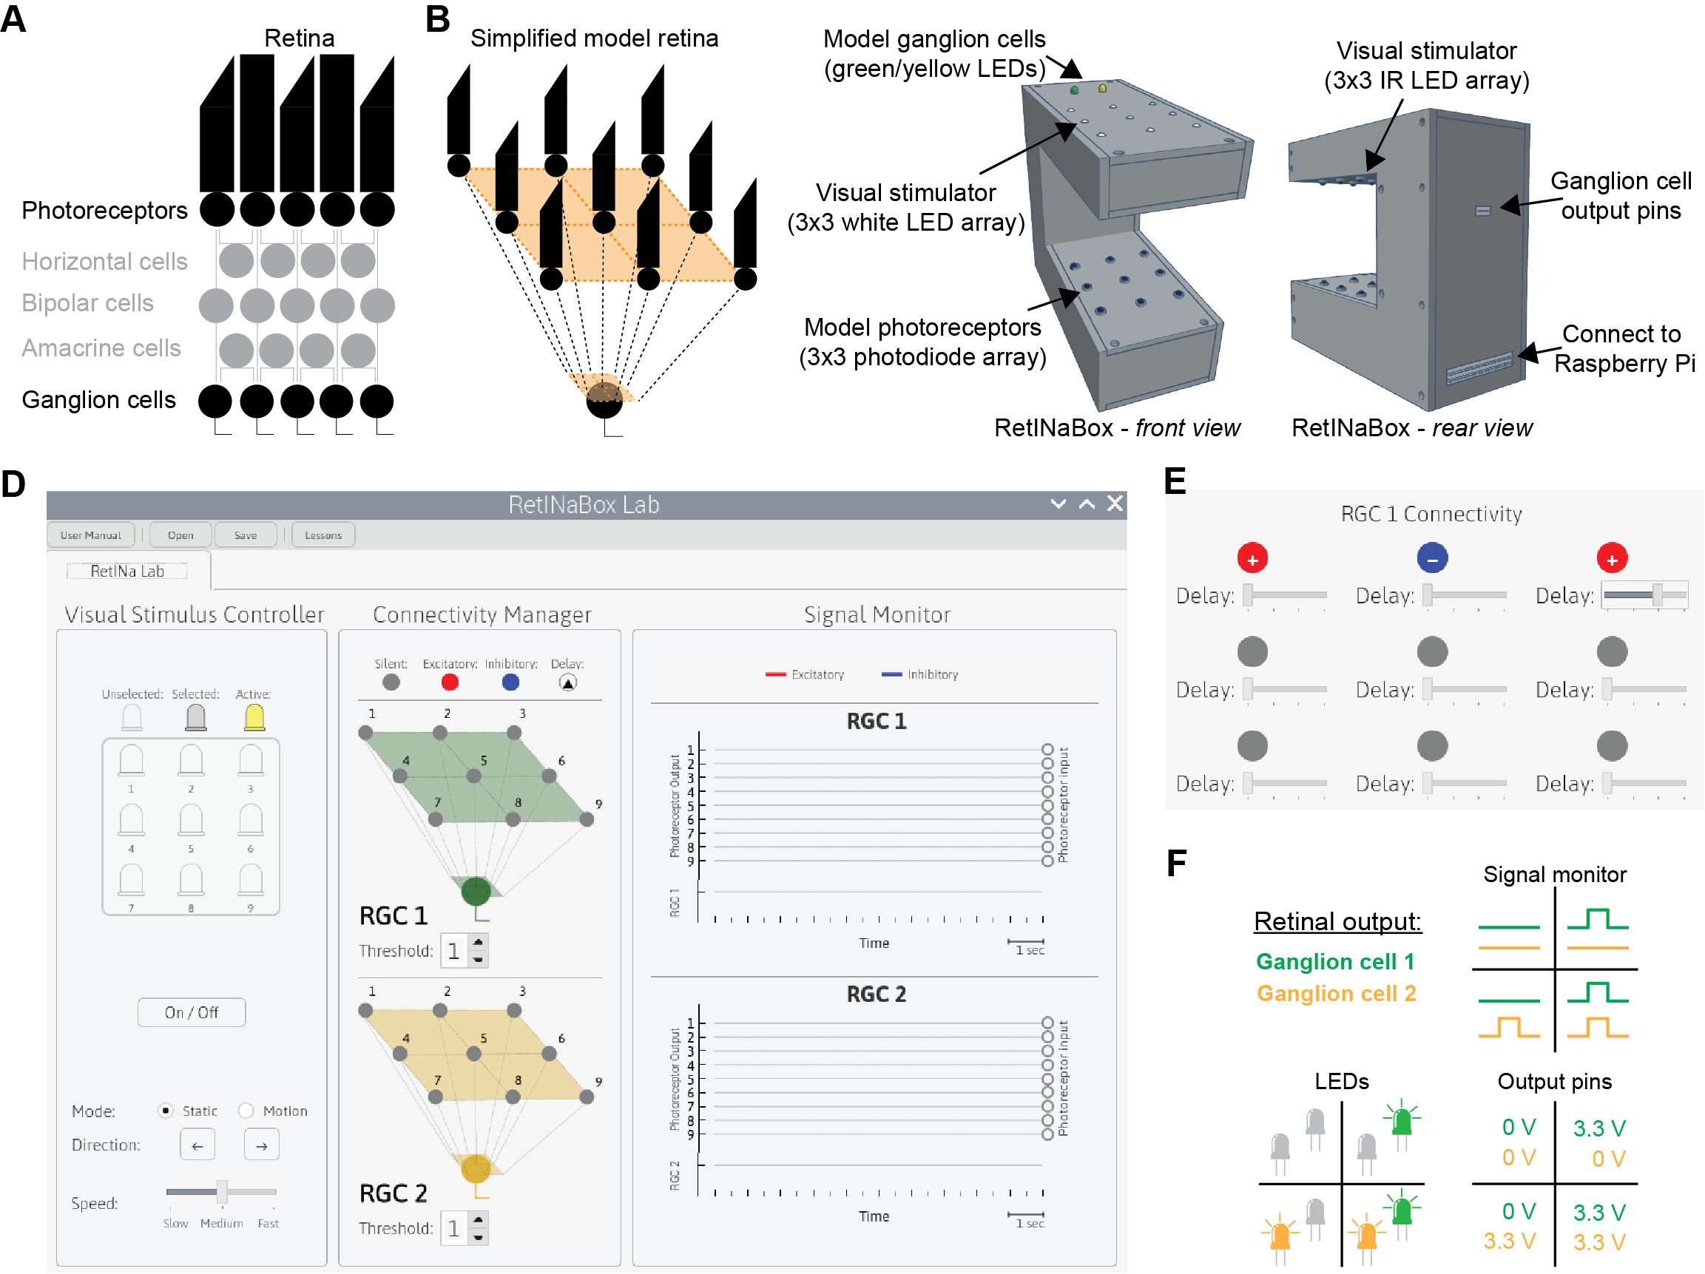
RetINaBox

Slide 6
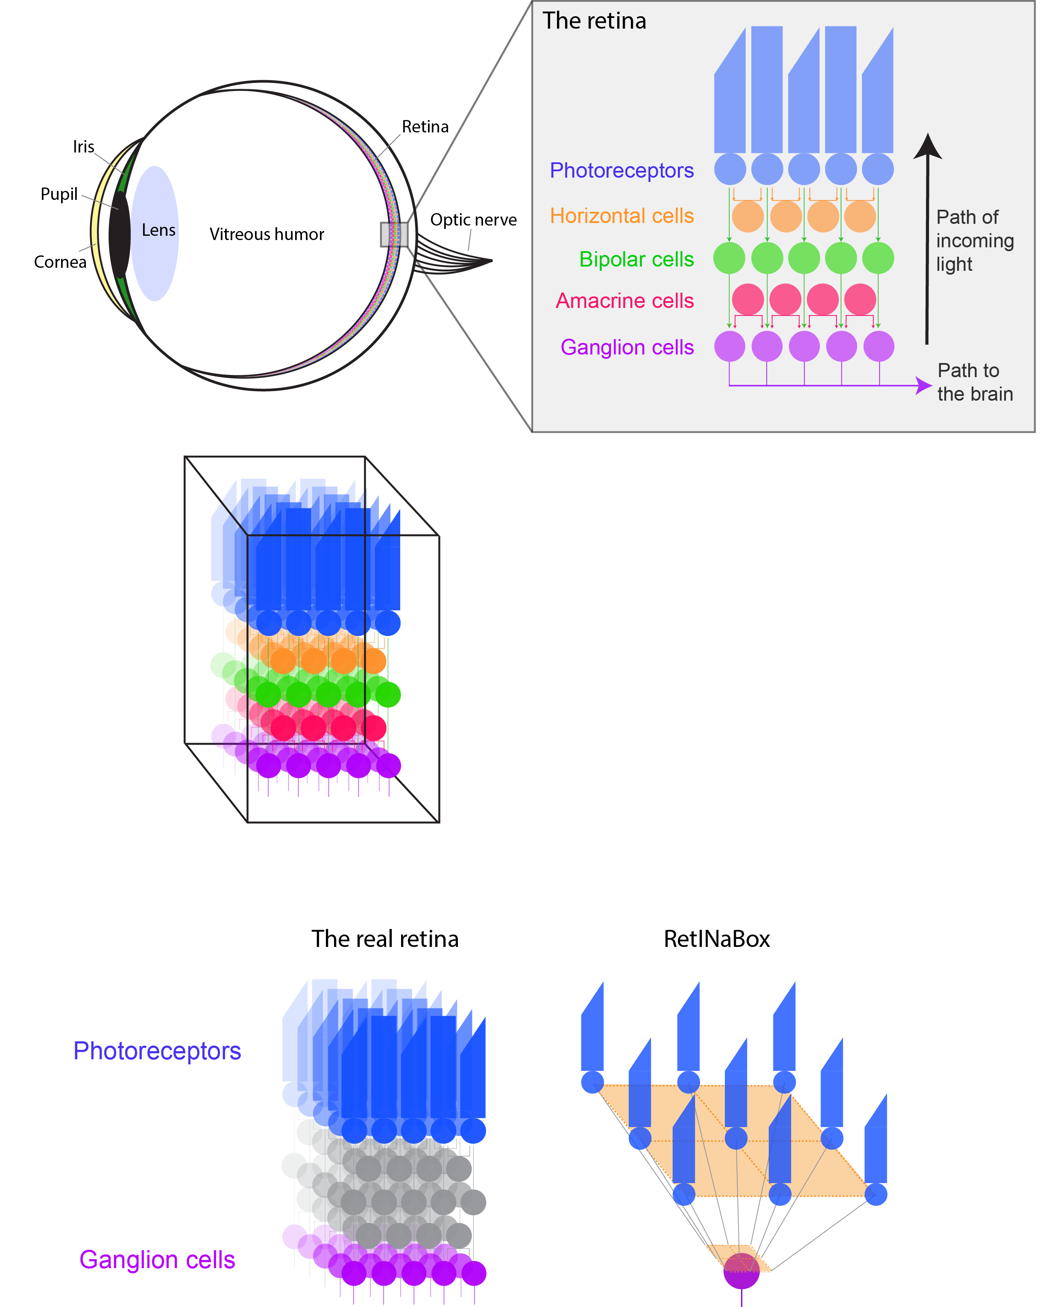
RetINaBox
Each ganglion cell responds when it receives positive inputs from a sufficient number of photoreceptors.
Each photoreceptor can connect to either or both ganglion cells.

Slide 7
RetINaBox
For each photoreceptor, you get to set:
Polarity
Time delay
For each ganglion cell, you get to set:
Threshold

Slide 8
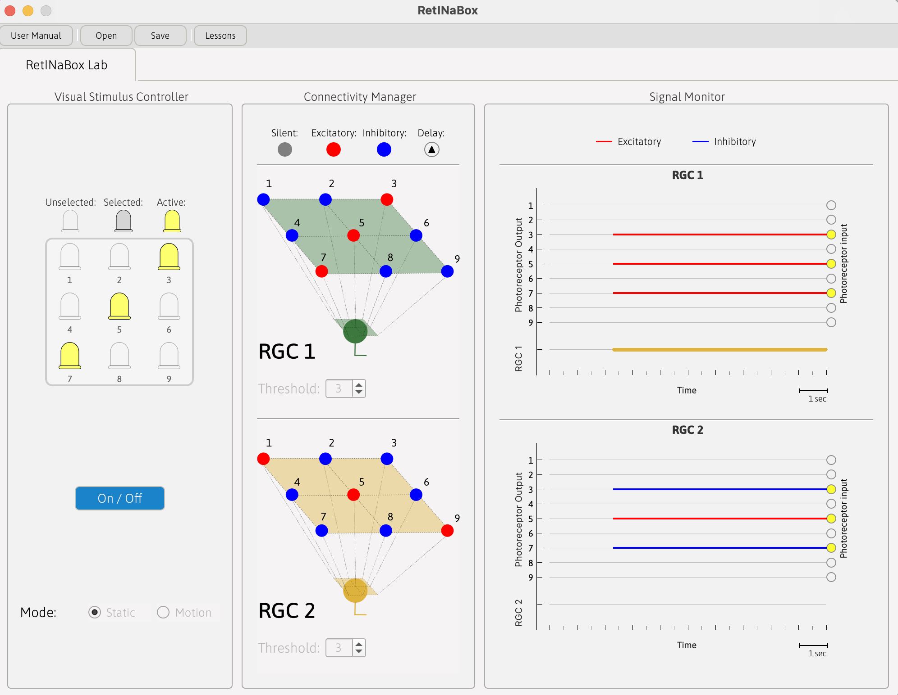
RetINaBox
Graphical User Inerface (GUI)

Slide 9

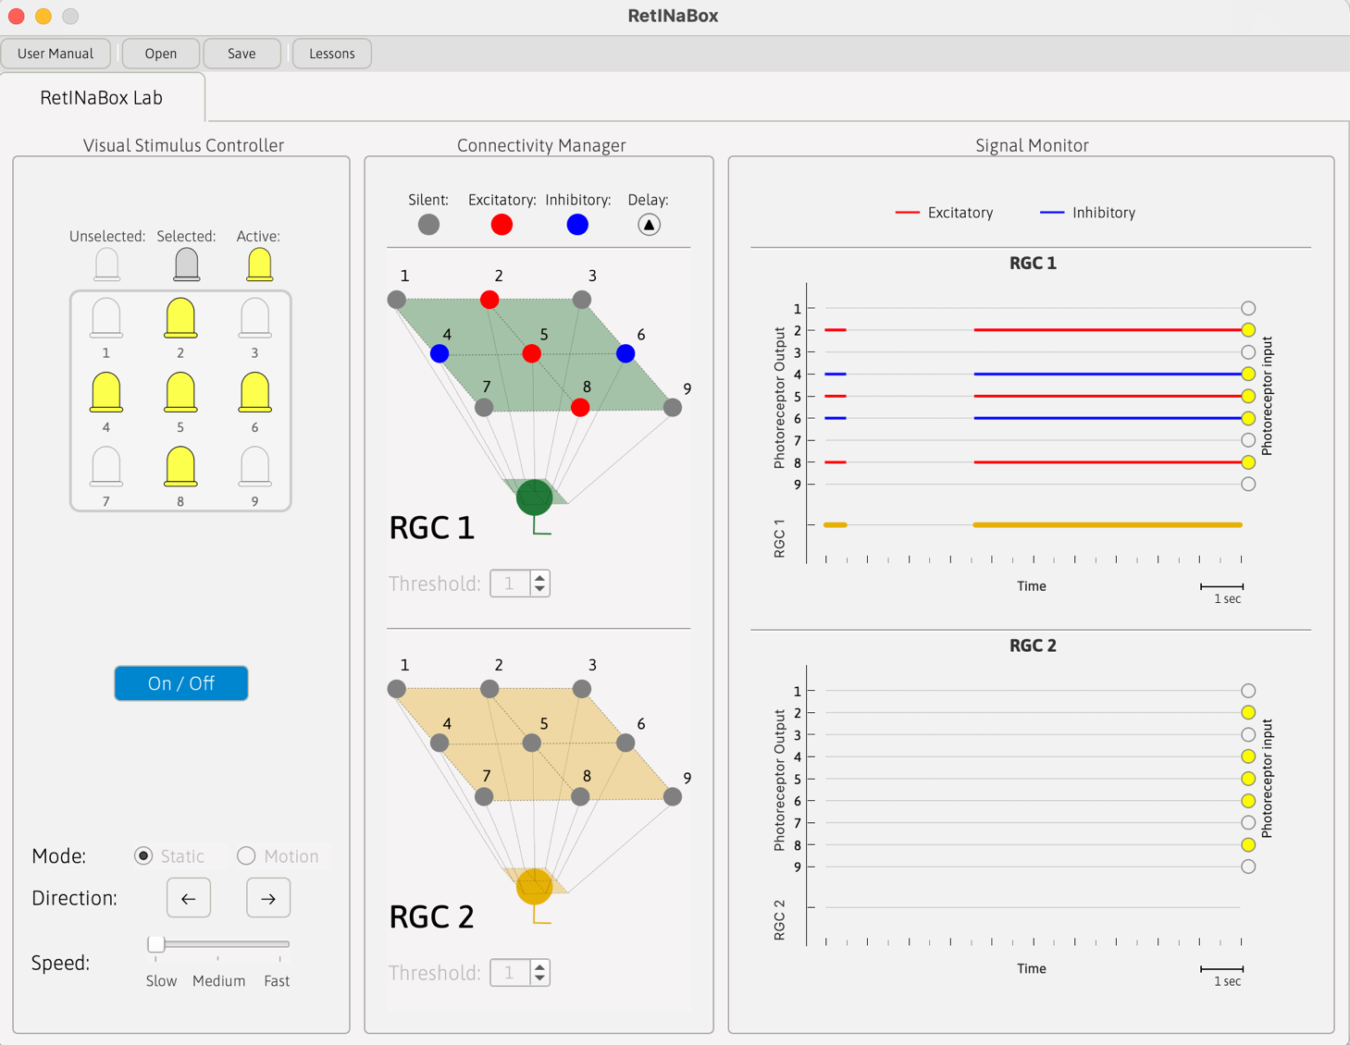
Visual Stimulus Controller

Slide 10
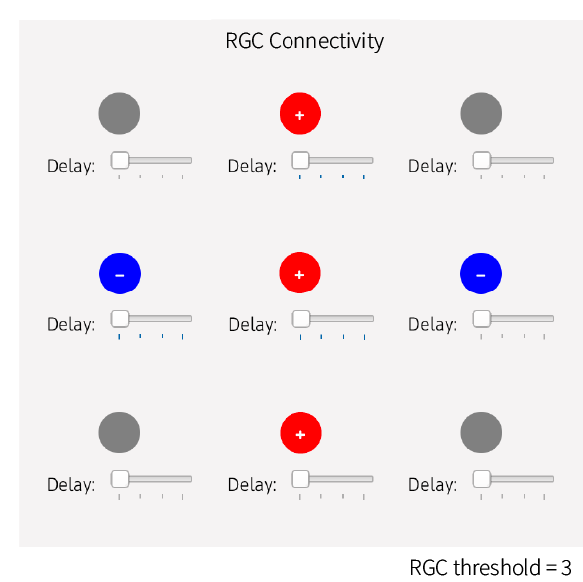
Connectivity Manager

Slide 11
Signal Monitor

Slide 12
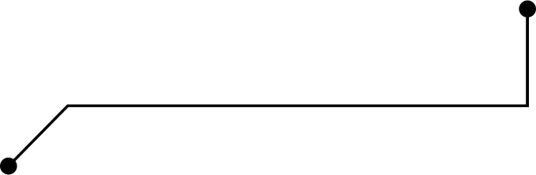
Objectives
Real-world stimulation
Build
Test
Build simple circuits that mimic retinal ganglion cell with different visual preferences
Test your circuit by activating different LEDs to check the ganglion cell’s selectivity
Use the Visual Stimulus Tool to see how robust your circuit is

Slide 13
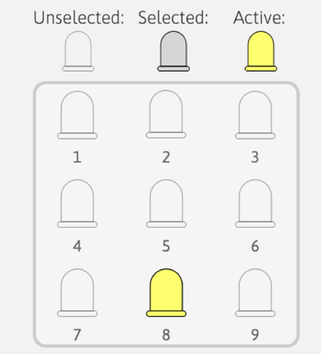
Testing your circuits
LED activation: manually activate different combinations of LEDs in the Visual Stimulus Controller to stimulate photoreceptors
Notes:
LED activation (beta testing): manually activate different combinations of LEDs in the Visual Stimulus Controller to stimulate the model photoreceptors with different patterns of light. This is a quick way to check that your circuit behaves as expected (i.e. that your ganglion cells respond selectively to specific visual stimuli). LED stimuli can be activated in either ‘Static’ or ‘Motion’ modes, corresponding to stationary or dynamically stimulation patterns. Use the ‘On/Off’ button to toggle LED activation (see Fig 5, left panel).

Slide 14
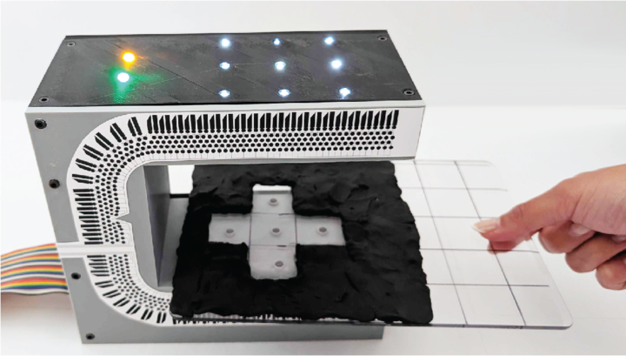
Testing your circuits
Turn on the entire LED array
Use the Visual Stimulus Tool (modeling clay on a clear plastic board) or your hands to deliver patterned visual stimuli
Notes:
Manual visual stimulation with the Visual Stimulus Tool (real-world testing): turn on the entire LED array. Then, create patterns with your Visual Stimulus Tool – modeling clay on a clear plastic board. Pass this board between the LED array and the photoreceptor array to selectively block light from reaching certain photoreceptors. This is the best way to test that your visual circuit respond selectively to specific real-world visual inputs.

Slide 15
Lesson 1
Center-Surround
How does your visual system know what to focus on in the world?

Slide 16
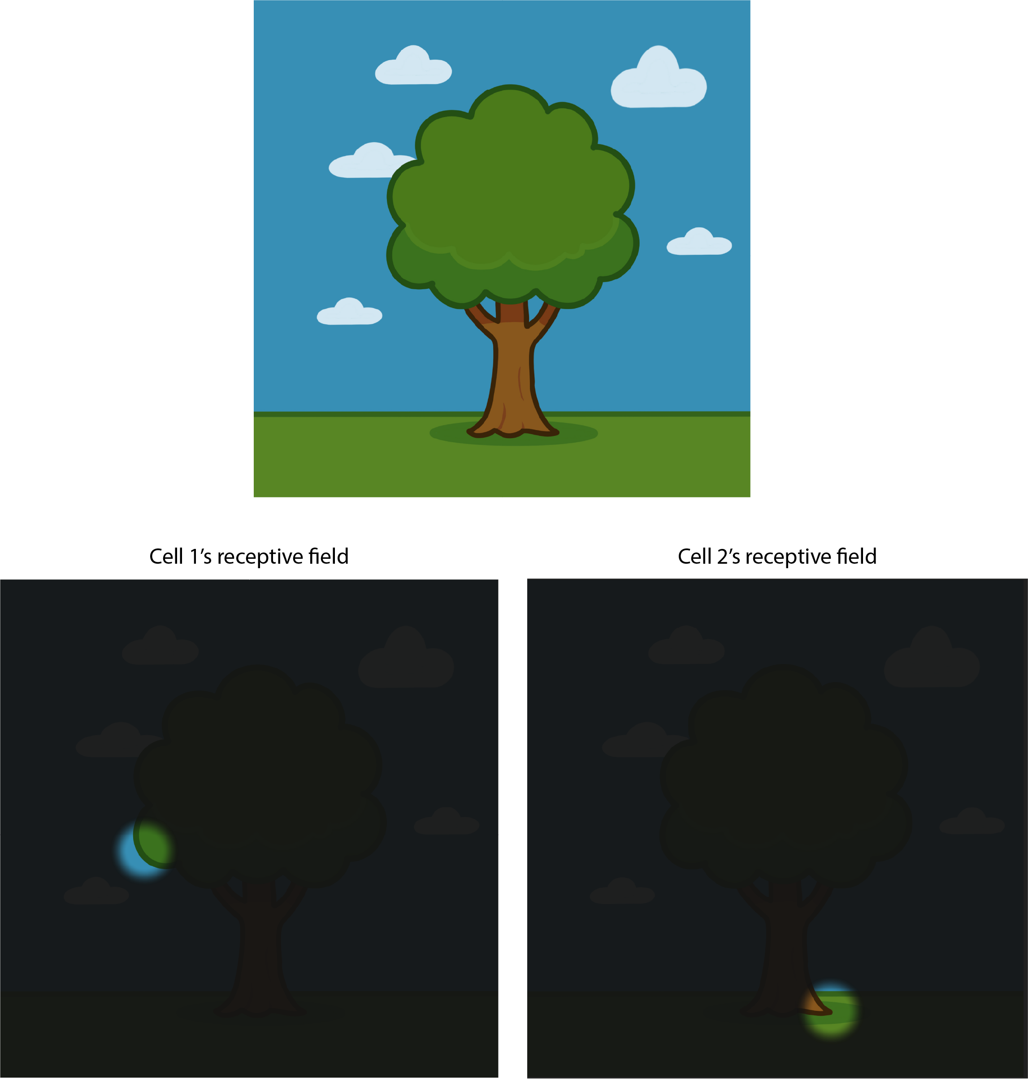
Receptive fields
Each visual neuron has a receptive field: a specific region of the retina (and therefore, of the visual world) where changes in light intensity can alter that neuron’s activity.

Slide 17
Center-surround tuning
Different neurons can have different sized receptive fields, meaning that different visual neurons prefer objects of different sizes in the visual field
This is useful for both locating objects and knowing how big they are in the world
Neurons with center-surround tuning respond to luminance contrast in their receptive field (i.e., when one part of the receptive field is bright while another is dark).
Notes:
slide 17 - change to "Neurons with center-surround tuning respond to luminance contrast in their receptive field" and "Different neurons can have different sized receptive fields, meaning that different visual neurons prefer objects of different sizes in the visual field."

Slide 18
Build a spot detector with an ON-center/OFF-surround receptive field (activated by light in the center of the receptive field but inhibited by light in the surrounding area)
Activity 1

Slide 19
Build a second spot detector with a different receptive field location
Activity 2

Slide 20
Build two spot detectors with preferences for spots of different sizes
Activity 3

Slide 21
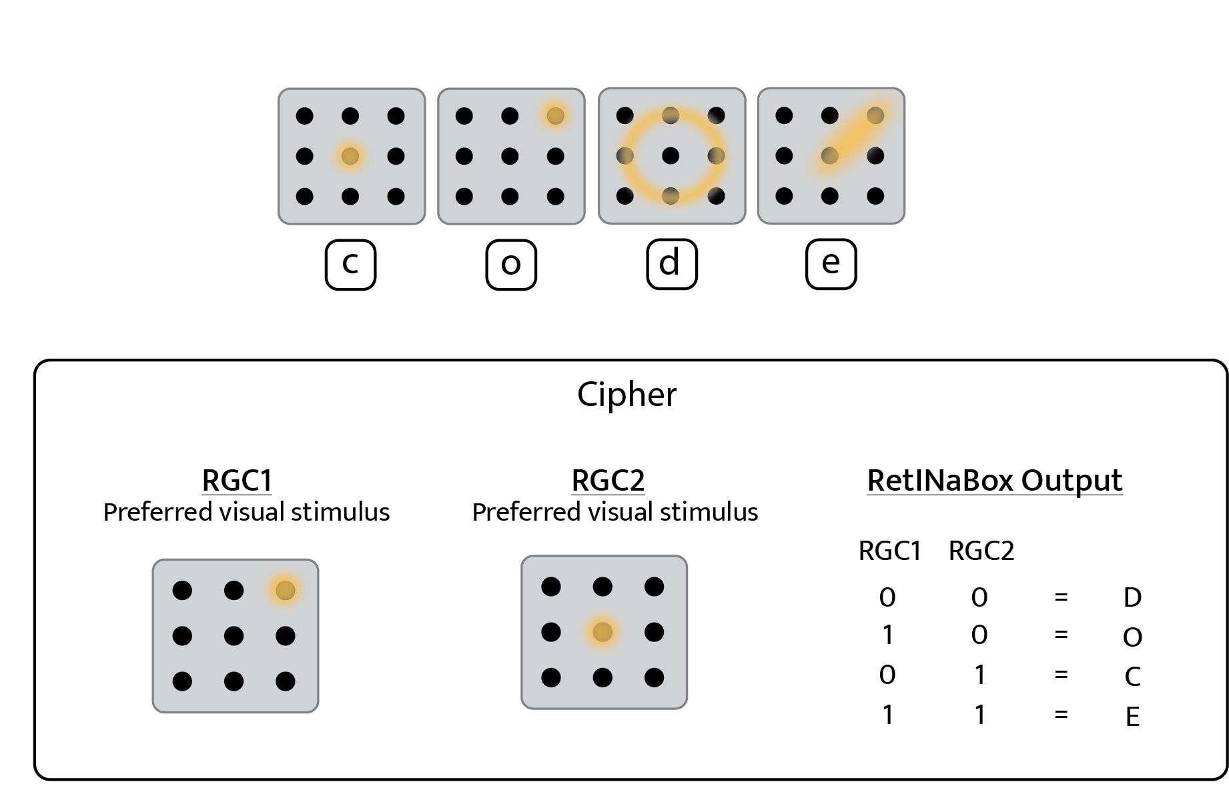
Challenge
Codebreaking with center surround receptive fields
To begin the challenge: Lessons > Lesson 1 > Code Breaker

Slide 22
Lesson 2
Orientation Selectivity
How do we recognize objects in the world?

Slide 23
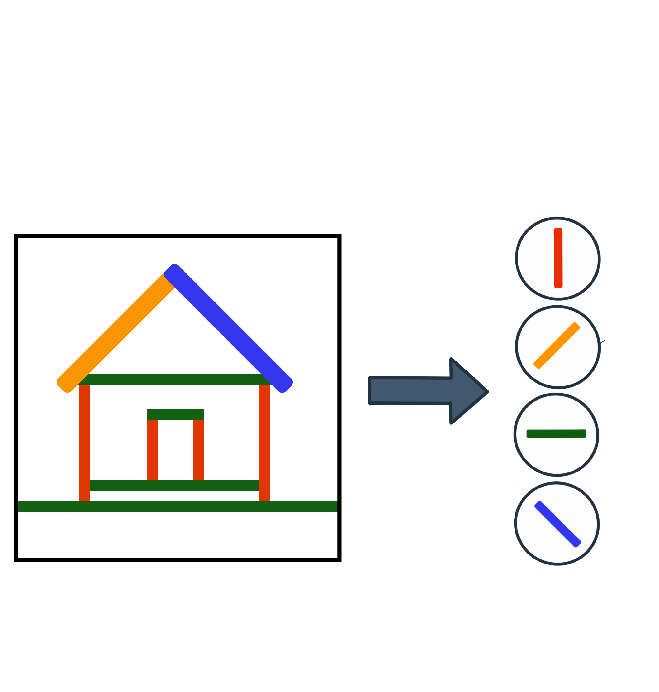
Orientation selectivity
Our visual system isn’t simply a collection of pixel detectors with center surround receptive fields.
Objects in our visual field can be decomposed into a set of edges/lines of different orientations and positions.

Slide 24
Orientation selectivity
Luckily, our retina also has cells that combine receptive fields from multiple neurons with spatially adjacent receptive field centers.
This can generate neurons that are selective to edges or lines of specific orientations within their receptive fields.

Slide 25
Activity 1
Build a ganglion cell that detects a vertical line

Slide 26
Activity 2
Build a second ganglion cell that detects a diagonal line

Slide 27
Build two ganglion cells that detect vertical lines of different thicknesses
Activity 3

Slide 28
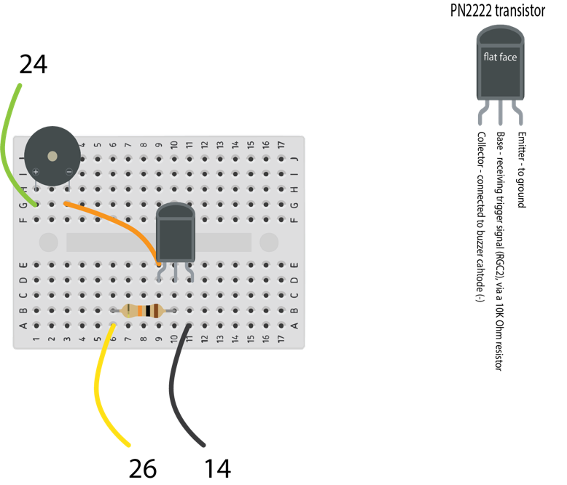
Challenge
Build a shape detector with orientation selective receptive fields
Combine the outputs of two orientation selective ganglion cells to detect a shape arising from the combination of two lines.
The buzzer should only sound when you present your target shape (i.e., both ganglion cells activated).
Once you’ve built the buzzer circuit (RetINaBox User Manual, page 14-15), connect the outputs of the two ganglion cells (the 3.3V digital out pins on the back of RetINaBox) and one of the grounds, to the buzzer circuit.

Slide 29
Lesson 3
Direction Selectivity
How do we know if and how objects are moving relative to us?

Slide 30
Build a leftward motion direction-selective ganglion cell
Activity 1

Slide 31
Build a rightward motion direction-selective ganglion cell
Activity 2

Slide 32
Build fast vs. slow motion preferring direction selective ganglion cells
Activity 3

Slide 33
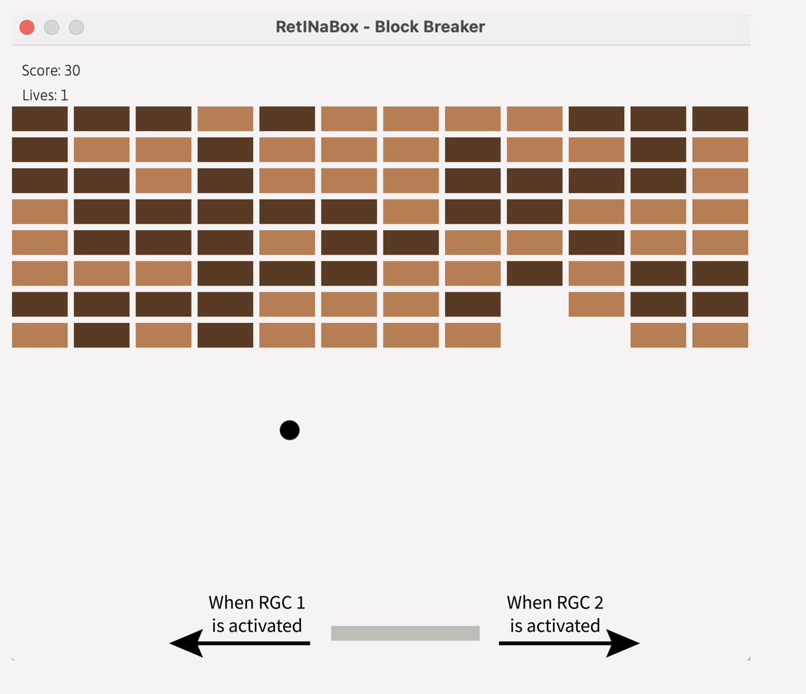
Challenge
Block Breaker
Players move a paddle to bounce a ball to break several rows of bricks. The goal is to clear all the bricks without letting the ball drop.
Your task is to configure two ganglion cells with opposite direction selectivity and use them as the input controls for the game inside the RetINaBox GUI.
Lessons > Lesson 3 > Block Breaker)

Slide 34
Lesson 4
Discovery Mode
It’s your turn discover which visual stimuli best activate visual neurons and discover what circuit connectivity properties underlie such feature selectivity.

Slide 35
Your goal is to complete each challenge with the highest score possible.
From the Menu tab, navigate to ‘Discovery Mode’ (Lessons > Lesson 4 > Discovery Mode). Then, select a mystery circuit from the drop-down menu.
In Discovery Mode, there are three levels of difficulty (Easy, Medium, Hard), each with their own set of challenges.
For each challenge, you’ll start with 100 points. Incorrect answers cost you 5 points.

Slide 36
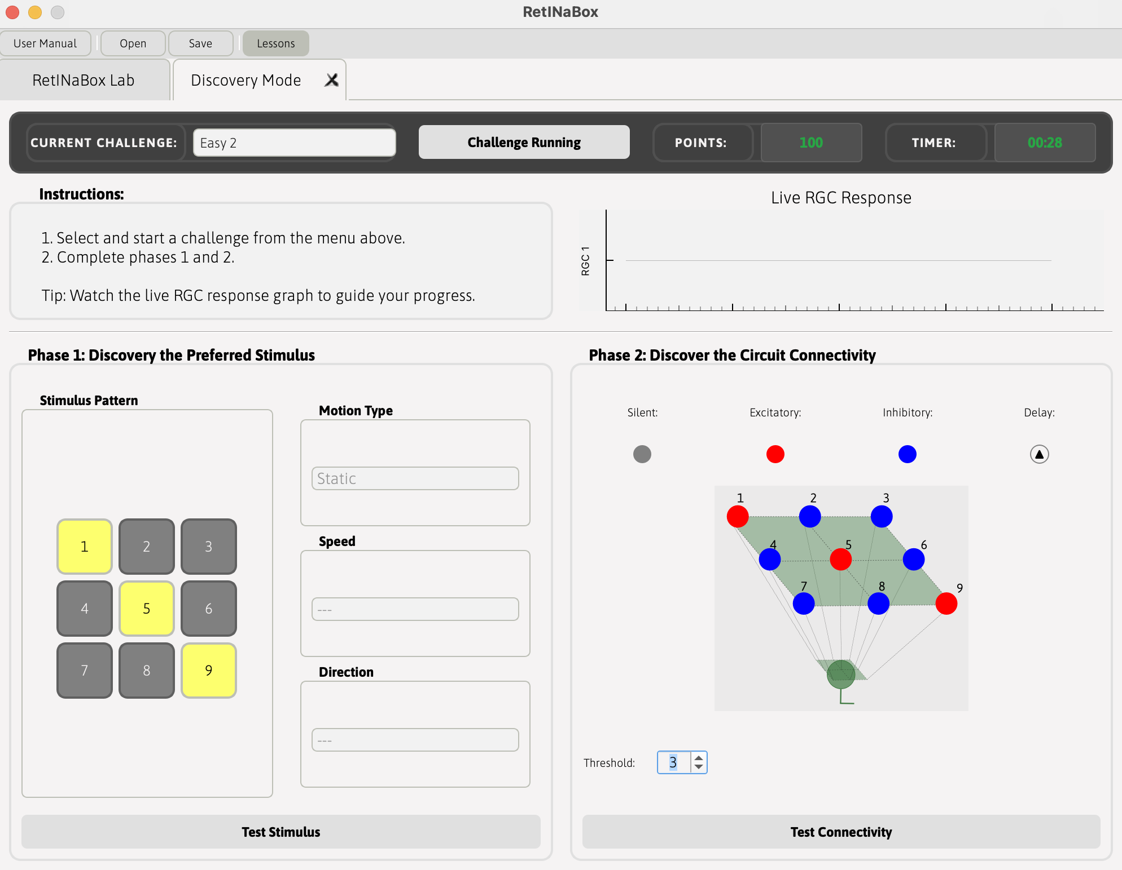
Phase 1: Discover the Preferred Stimulus
Figure out what each ganglion cell responds to (i.e., a specific shape, or a direction of motion, etc.).
Phase 2: Discovery the Circuit Connectivity
Figure out how the ganglion cell obtains this selectivity.

Slide 37
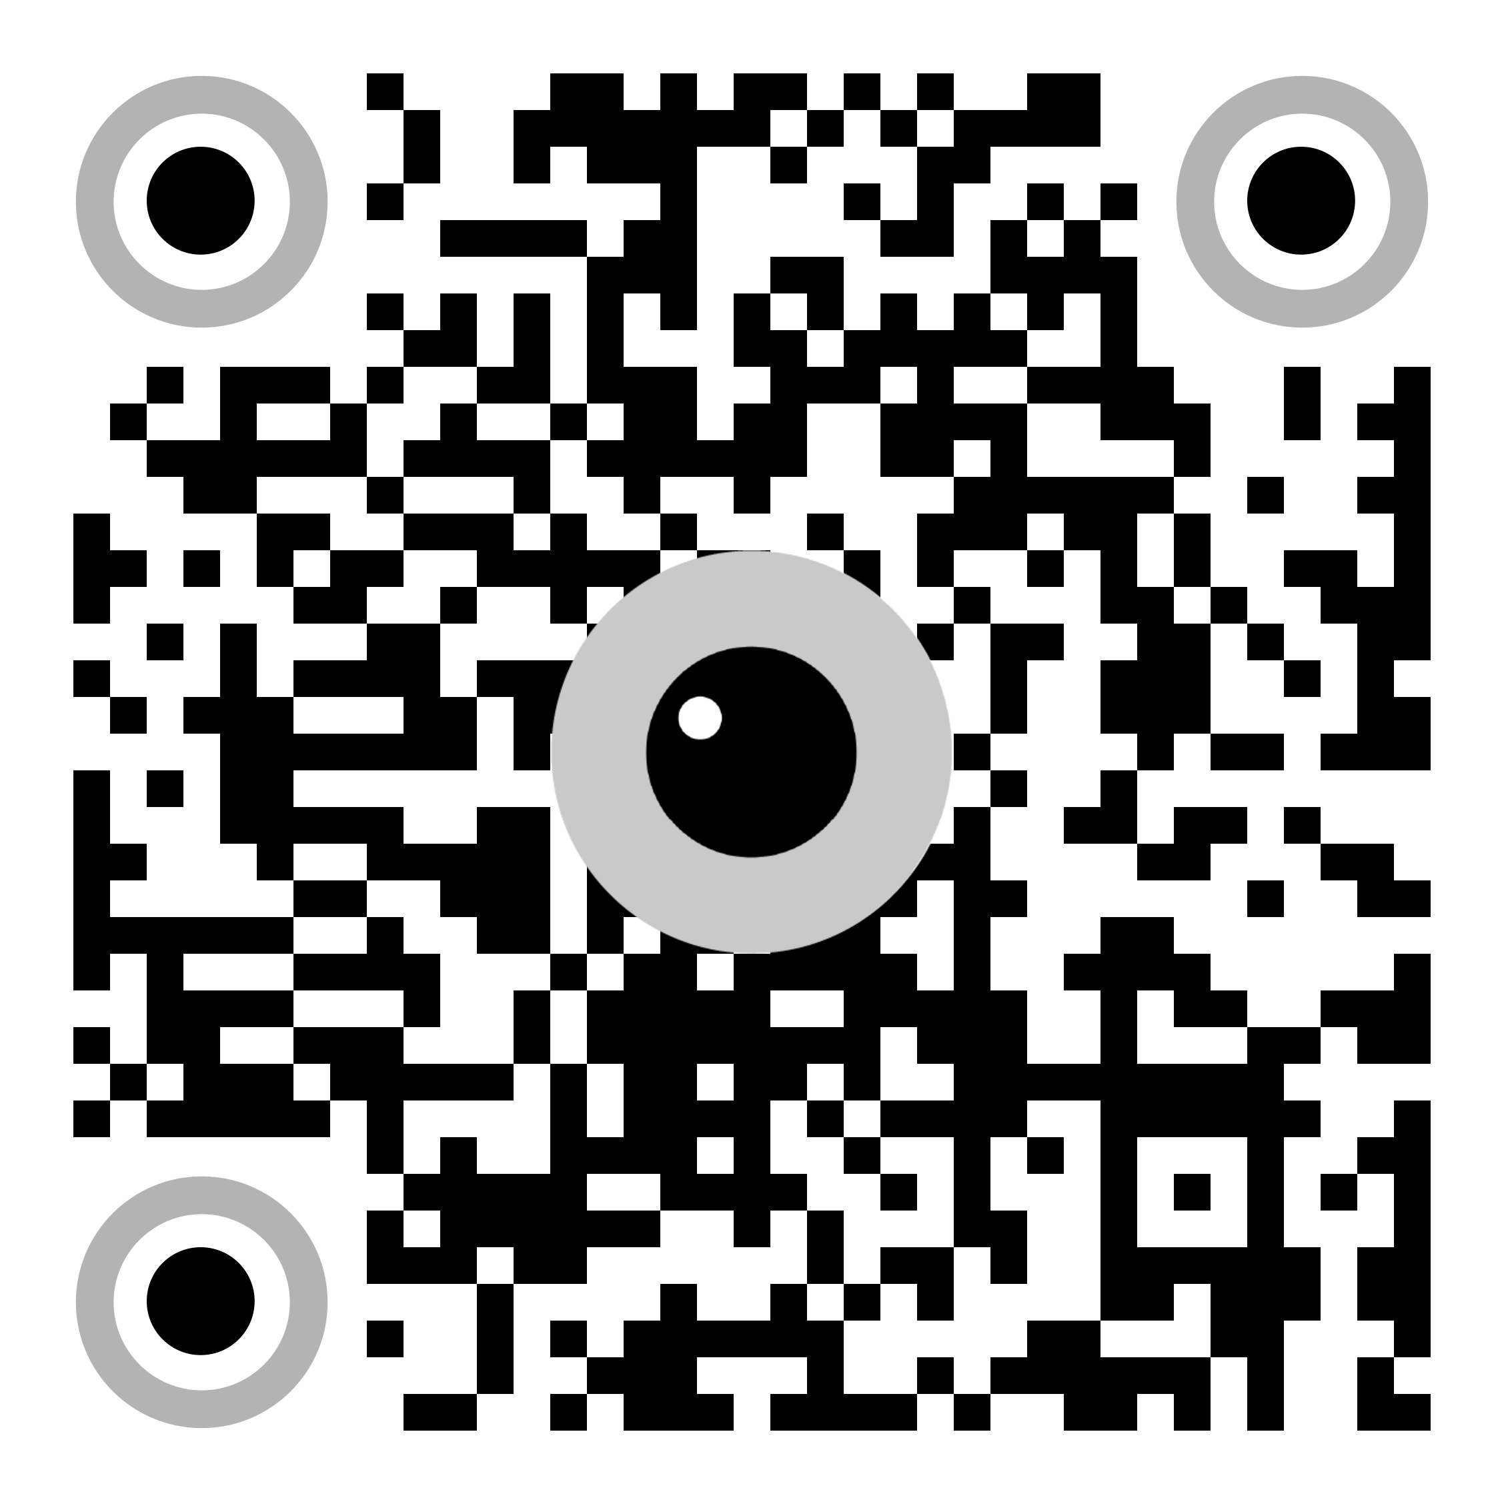
Solutions and additional details are available in the Lesson Plan.
Instructions for setting up hardware and software are available in the RetINaBox User Manual

Slide 38

Thank You!
Developed by the
Trenholm Lab at McGill University
Code and materials: https://github.com/Trenholm-Lab/RetINaBox
For a more detailed overview of the retina and the visual system, visit theopenbrain.org

